Slide 1
Surveillance for Coronavirus Disease – 2019
(COVID-19)
Orientation of the National
Rapid Response Team
03 March 2020

Slide 2
Learning objectives
By the end of this presentation, participants will be able to describe:
Enhanced surveillance
How to conduct outbreak investigations in different settings
How to conduct contact tracing

Slide 3

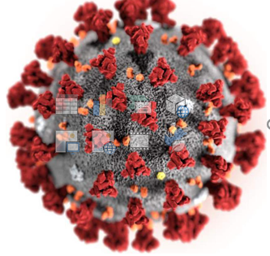
Background
In December 2019, a novel coronavirus (COVID-19) started an outbreak of pneumonia in Wuhan, China
COVID-19 is related to SARS-CoV and MERS-CoV.
Initial origin was probably zoonotic but human-human transmission is highly likely.
Number of cases is increasing rapidly, most patients have mild illness, presenting with fever, cough, fatigue & myalgia.
Management involves early recognition, strict IPC and supportive care, oxygen for severe cases.
Notes:
On 31 December 2019, the WHO China Country Office was informed of pneumonia cases of unknown cause in Wuhan City, Hubei Province of China. A novel coronavirus (COVID-19) was isolated and identified as the causative virus by Chinese authorities on 7 January.
Since then the virus has spread to 67 countries
In Africa region 3 countries are affected

Slide 4
Coronaviruses
Large, enveloped, positive-strand RNA viruses
4 human (H) CoVs cause 10-30% of URTIs in adults
SARS-CoV, MERS-CoV & COVID-19 can cause severe human infections
Notes:
SARS
Viral respiratory illness
First recognized in November 2002 in China
2002-2003 global outbreak
8,098 probable cases
774 deaths
No known human cases since 2004
Spread by close person-to-person contact
Symptoms often include:
Fever, chills, and body aches progressing to pneumonia
MERS
Viral respiratory illness
First reported in 2012 in Saudi Arabia
Human illnesses in dozens of countries (in or near Arabian Peninsula) since
2 cases reported in 2014 in U.S.
Both cases were among healthcare providers who traveled to the U.S. from Saudi Arabia
MERS remains a very low risk illness to the general public in the U.S.
As of October 3, 2019
>2400 lab-confirmed cases
>850 deaths
Spreads from ill people to others through:
Close contact (caring for or living with an infected person)
Healthcare settings, such as hospitals
Animal exposure (i.e. camels and bats)
Travel
Symptoms may include:
Fever, chills, headache, cough, shortness of breath, diarrhea and nausea/vomiting
Symptoms begin about 5-6 days after exposure, but can range from 2-14 days
Severe complications include pneumonia and kidney failure
~3 or 4 out of every 10 people reported with MERS have died.
Chance of death increases with age and presence of underlying medical conditions
Prevention
Currently no vaccine (in development)
Reduce risk of respiratory illnesses:
Wash hands often, for at least 20 seconds.
If soap and water are unavailable, use an alcohol-based rub
Cover your mouth and nose with a tissue
Avoid touching your eyes, nose or mouth
Avoid close contact
Clean and disinfect frequently touched surfaces
Treatment
No specific antiviral treatment

Slide 5
Coronaviruses
Key feature of coronaviruses which cause SARI:
Limited human-human transmission, predominantly nosocomial
Viral replication in the upper and lower respiratory tract.

Slide 6
Objectives of COVID-19 Surveillance
Rapidly detect new cases
Provide epidemiological information to conduct risk assessment
Provide epidemiological information to guide response measures
Monitor trends of the disease where human to human and/or zoonotic transmission occurs

Slide 7
COVID-19 CASE DEFINITION (DYNAMIC)
Case definitions for surveillance
The case definitions are based on the current information available and will be revised as new information accumulates. Countries may need to adapt case definitions depending on their own epidemiological situation.
Suspect case
A. A patient with acute respiratory illness (fever and at least one sign/symptom of respiratory disease (e.g., cough, shortness of breath), AND with no other aetiology that fully explains the clinical presentation AND a history of travel to or residence in a country/area or territory reporting local transmission (See situation report) of COVID-19 disease during the 14 days prior to symptom onset.
OR
B. A patient with any acute respiratory illness AND having been in contact with a confirmed or probable COVID-19 case (see definition of contact) in the last 14 days prior to onset of symptoms;
OR
C. A patient with severe acute respiratory infection (fever and at least one sign/symptom of respiratory disease (e.g., cough, shortness breath) AND requiring hospitalization AND with no other aetiology that fully explains the clinical presentation

Slide 8
CASE DEFINITION (DYNAMIC)
Probable case
A suspect case for whom testing for COVID-19 is inconclusive.
Confirmed case
A person with laboratory confirmation of COVID-19 infection, irrespective of clinical signs and symptoms
Recommendations for follow-up of contacts
Definition of contact
A contact is a person that is involved in any of the following:
Providing direct care without proper personal protective equipment (PPE) for COVID-19 patients
Staying in the same close environment of a COVID-19 patient (including workplace, classroom, household, gatherings)
Traveling together in close proximity (1 m) with a COVID-19 patient in any kind of conveyance within a 14‐day period after the onset of symptoms in the case under consideration.

Slide 9
CASE DEFINITION (DYNAMIC)
Recommendations for laboratory testing
Any suspected case should be tested for COVID-19 infection using available molecular tests. However, depending on the intensity of the transmission, the number of cases and the laboratory capacity, only a subset of the suspect cases may be tested.
If resources allow, testing may be done more broadly (for instance through sentinel surveillance) to better assess the full extent of the circulation of the virus.
Based on clinical judgment, clinicians may opt to order a test for COVID-19 in a patient not strictly meeting the case definition, for example, if there are patients involved in a cluster of acute respiratory illness among healthcare workers or of severe acute respiratory infection (SARI) or pneumonia in families, workplaces or social network.

Slide 10
CASE DEFINITION (DYNAMIC)
Recommendations for reporting surveillance data to WHO
Case based Reporting:
WHO requests that national authorities report probable and confirmed cases of novel coronavirus COVID-19 infection within 48 hours of identification, by providing the minimum data set outlined in the “Revised case reporting form for 2019 Novel Coronavirus of confirmed and probable cases”, through the National Focal Point and the Regional Contact Point for International Health Regulations at the appropriate WHO regional office.
A template for the revised line listing in Excel format with the data dictionary, which suggests the name of the variables and their specifications is available. If the outcome of the patient is not yet available at first reporting an update of the report should be provided as soon as outcome is available latest within 30 days of the first report.
Reporting of case-based report is requested as long as feasible for the country. When it is not feasible to report case-based data, countries are requested to provide daily and weekly aggregated data.
Daily aggregated data
WHO requests reporting of the number of new confirmed cases by first administrative level (e.g. region, province, state, municipalities) and deaths
Notes:
Case based reporting is the systematic reporting of newly diagnosed cased and sentinel events

Slide 11
COVID-19 TRANSMISSION
Cluster of cases of pneumonia reported in Wuhan on 31 Dec 2019, with 1st case symptomatic on 8 Dec.
Initial cases associated with a market in Wuhan, animal source remains to be identified
Rapid spread within Wuhan and to many other Chinese provinces and other countries
Limited human-human transmission, but full extent not yet known (+ Health care workers)
Spread is through droplets and contact

Slide 12

COVID-19 TRANSMISSION
Incubation period: mean 6.4 days (95% credible interval: 5.6-7.7), ranging from 2.1 to 11.1 days (2.5th to 97.5th percentile).
Viral shedding relation to clinical symptoms remains to be better characterized.
Notes:
Incubation period is the time elapsed between exposure to a pathogenic organism, a chemical or radiation and when symptoms and signs are first apparent

Slide 13
Symptoms of COVID-19
Usually cause mild to moderate upper-respiratory tract illnesses, like the common cold
Advanced Stage:
  All of the earlier symptoms plus
  Pneumonia*
  Bronchitis*
  Kidney failure
  *More common in people with underlying conditions such as weakened immune systems, infants and older adults.
Early Stage:
  Fever (>38C)
  AND
  Respiratory symptoms:
  Cough
  Shortness of breath
  Runny nose
  Weakness
  Malaise
  Nausea/vomiting
  Diarrhea
  Headache

Slide 14
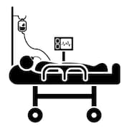


Epidemiological study from China CDC
n = 72,314
44,672 confirmed (61.8%)
16,186 suspected (22.4%)
10,567 clinically-diagnosed (14.6%)
3,019 HCW infections
889 asymptomatic (1.2%)
Distribution of cases
  81% mild
  14% severe
  5% critical
  2.3% fatal (CFR)
5%
critical
14% severe
81% mild
Source: China CDC Weekly submitted 14.02.20

Slide 15
COVID-2019 - CLINICAL FEATURES
Symptoms at onset*:
      fever (83-98%),
      dry cough (59-82%),
                fatigue & myalgia (11-44%),
                sputum production (15-28%),
                headache (8%),
                haemoptysis (5%),
                diarrhoea (3-10%)
dyspnoea (31-55%)
Huang, C. et al Lancet 2020 China CDC 2020
Wang, D. et al JAMA 2020
Chen, D et al. Lancet 2020
Notes:
Dyspnea labored breathing …difficulty on breathing

Slide 16
COVID-2019: newborns and pregnant women
Small cohort of 9 COVID-2019 pregnant women and 10 neonates.
  All neonates tested negative by throat swab,
  Intrauterine fetal distress in 6 of 10 neonates,
  4 full term, 6 premature, 1 died.
  Conclusion: no evidence of vertical transmission.

Slide 17
COVID-2019 - INVESTIGATIONS*
INVESTIGATIONS*:
Blood: leucopenia (25%), lymphopenia (9-70%), elevated Liver Functional tests-aspartate aminotransferase-AST (37%)
Radiology - Chest abnormalities in all patients (bilateral in 98%); typically bilateral lobular & sub segmental consolidation
Huang, C. et al Lancet 2020
Wang, D. et al JAMA 2020
Chen, D et al. Lancet 2020
Notes:
Leucopenia - Low white blood cell count
Lympopenia ---an abnormally low level of lymphocytes in the blood

Slide 18
COVID-2019 Critical illness
Single-centre, retrospective study: 170 total patients, 52 ICU patients:
  40% chronic disease (co-morbid condition before)
  71% treated with invasive ventilation
  67% Acute Respiratory Distress Syndrome, 29% Acute Kidney Injury, 23% cardiac injury, 29% liver dysfunction, 35% hyperglycemia
  31 deaths at 28 days (62%)* Could be higher as patients still on ventilator when published.

Slide 19
COVID-19 – CLINICAL MANAGEMENT
Triage and early recognition
Implement immediate strict IPC interventions.
Early diagnosis and alert of public health authorities.
Supportive and intensive care interventions for SARI and sepsis.
Antimicrobials therapy for co-infection (sepsis)
Prevention of complications .
Quality care and Ethics.
Clinical Research

Slide 20
WHO AFRO Region (as of 28 Feb 2:00am)
Confirmed cases
New confirmed case: 1
New deaths (confirmed): 0
Total confirmed cases: 2
Total deaths (confirmed): 0
No. of countries with confirmed cases: 2
Country | Region | Date notified | Cases | Deaths | Summary
Algeria | Hassi Messaoud, WILAYA DE OUARGLA | 25-Feb-20 | 1 | 0 | An 61-year-old Italian male with underlying comorbidity (not specified) was confirmed positive for COVID-19 infection by the National Reference Laboratory for influenza and respiratory viruses of the Pasteur Institute of Algeria. The case originally came from Milan and arrived in Algeria on 17 February 2020 in the city of Hassi Messaoud, 800km south-east of the capital Algiers and reportedly developed symptoms on 22 February. Currently, he is being managed in an isolation facility.
Nigeria | Lagos | 28-Feb-20 | 1 | 0 | The Federal Ministry of Health of Nigeria announced the first confirmed case of COVID-19 in Lagos, Nigeria. The case is an Italian citizen who works in Nigeria and returned from Milan, Italy to Lagos, Nigeria on 25 February 2020. He reportedly developed symptoms on 26 February and was confirmed on 27 February COVID-19 infection by the Virology Laboratory of the Lagos University Teaching Hospital on 27 February 2020. The patient is reported to be clinically stable, with no serious symptoms, and is being managed at the Infectious Disease Hospital in Yaba, Lagos.

Slide 21
COVID-19 – WHO Website
https://www.who.int/emergencies/diseases/novel-coronavirus-2019
https://www.who.int/blueprint/priority-diseases/key-action/novel-coronavirus/en/
https://www.who.int/emergencies/diseases/novel-coronavirus-2019/technical-guidance

Slide 22
Country Readiness for COVID-19

Slide 23
Readiness status by country for COVID-19
8
33
6

Slide 24
Readiness status by response pillar for COVID-19

Slide 25
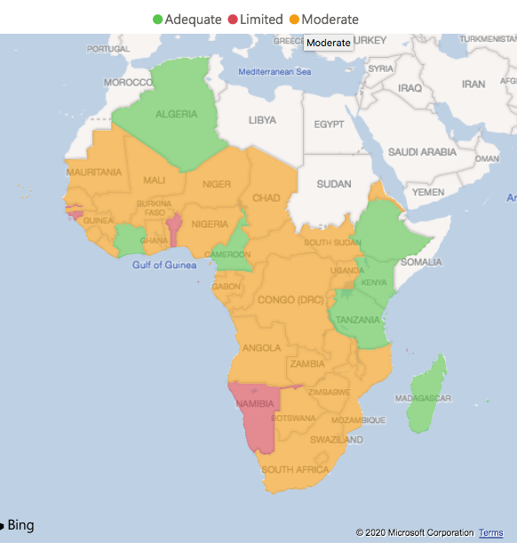
Country Readiness compiled on 02 February
(Initial Assessment & the situation may have changed)
Readiness Checklist
Points of Entry
Rapid Response Teams
Surveillance
Laboratory
Case management
Risk Communication and community engagement
Infection Prevention and Control
Coordination
Logistics
Overall regional readiness score 66%
https://app.powerbi.com/view?r=eyJrIjoiNWY4NTQyNWMtZjllYS00MjA0LTg0MjYtMjRkNGE0ZmZiYmI5IiwidCI6ImY2MTBjMGI3LWJkMjQtNGIzOS04MTBiLTNkYzI4MGFmYjU5MCIsImMiOjh9
Notes:
Readiness checklist was distributed to 47 countries and all member states responded.
Checklist covers 10 key pillars for preparedness and response
Overall regional readiness score is average score across all pillars

Slide 26
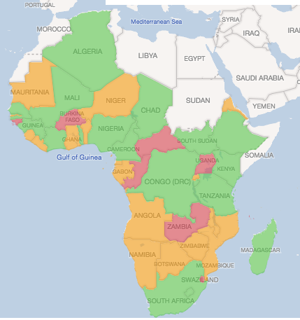
Country Readiness – Points of Entry(PoE)
All the 23 priority 1 and Priority 2 countries are conducting screening at the PoEs – mainly airport and some seaports
Alerts detected at the PoE were investigated and discarded following a negative result
Countries have assessed the on-going screening at the PoEs and gaps identified are being addressed
All countries are expected to conduct simulation exercises at the PoEs to test their readiness capacity
Overall score PoE readiness 70%
Notes:
Readiness checklist was distributed to 47 countries and all member states responded.
Checklist covers 10 key pillars for preparedness and response
Overall regional readiness score is average score across all pillars

Slide 27
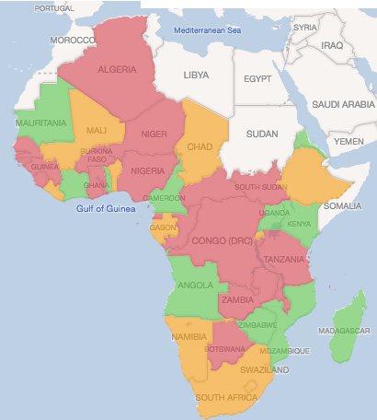
Country Readiness – Rapid Response Teams (RRT)
Over 1500 members of national Rapid Response Teams were trained.
A pool of over 300 international facilitators English, French and Portuguese speaking has been established.
35 countries trained:
Overall score RRT readiness score 53%
When an alert is given, the RRT is deployed for investigation and initiation of containment measures. RRT is a multidisciplinary team of 5 to 7 persons.
Notes:
Readiness checklist was distributed to 47 countries and all member states responded.
Checklist covers 10 key pillars for preparedness and response
Overall regional readiness score is average score across all pillars

Slide 28
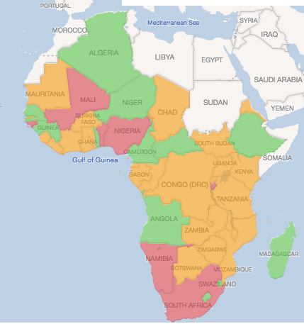
Country Readiness - Surveillance
Overall readiness of surveillance systems in countries is 65%
Technical interim guidance, tools and global update regularly shared with countries
    Global update on COVID-19 regularly
    COVID-19 surveillance training presentation
    COVID-19 case definition, reporting form, line list and data dictionary shared
    Protocols for early investigation shared with specific guidance for AFRO countries to use the First
    Few X cases and close contact investigation protocol
Urgent actions to be implemented to strengthen surveillance have been shared
with all countries based the analysis of the checklist as follows:
  All countries to accelerate dissemination of surveillance tools at health Facilities, PoEs and influenza ILI
  and SARI sentinel sites if applicable
  All countries to make sure that health workers have adequate understanding of how to use COVID surveillance tools (training, supervision etc)
  Countries that didn’t have ILI and SARI in their list of priority disease under IDSR to include these two key diseases in their list using the 3rd edition of the IDSR Technical guideline
  SARI sentinel surveillance in the 28 countries to actively contribute to COVID-19 surveillance
  All countries to activate/set up toll free number to report COVID-19 alert
  All countries to develop an algorithm for COVID-19 alert management as well as for surveillance at point of entries
  All countries to familiarize with the First Few X (FFX) cases and contact protocol for early investigation and contact tracing
              Monitoring of progress through periodic completion of surveillance checklist
Notes:
Readiness checklist was distributed to 47 countries and all member states responded.
Checklist covers 10 key pillars for preparedness and response
Overall regional readiness score is average score across all pillars

Slide 29
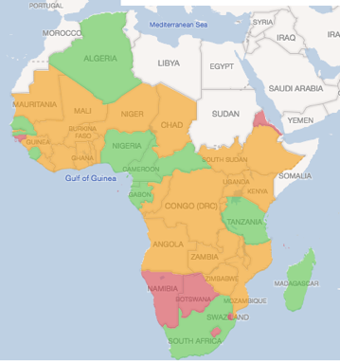
Country Readiness - Laboratory
33 countries in the region can test for SARS-CoV-2 virus
  2 Global Referral Labs: Institut Pasteur, Dakar, Senegal and National Institute for Communicable Diseases, Johannesburg, South Africa.
  100% of NIC (13)
  30 laboratories were trained on molecular detection of COVID-2019 (Africa CDC/WHO workshops)
Procurement of other reagents/supplies for specimen collection and testing in process for 40 countries
Overall laboratory readiness score 71%
Notes:
Readiness checklist was distributed to 47 countries and all member states responded.
Checklist covers 10 key pillars for preparedness and response
Overall regional readiness score is average score across all pillars

Slide 30
Testing of Specimens – projected capacity
As of 3 February
As of 1 March**
Projected*
Cabo Verde
Sao Tome & Principe
Cabo Verde
Sao Tome & Principe
Cabo Verde
Sao Tome& Principe
Comoros
Comoros
Comoros
EMRO
Mauritius
Seychelles
Mauritius
Seychelles
Mauritius
Seychelles
Countries outside the WHO African Region
40 countries have requested reagents through WHO
33 countries have testing up and running in the lab
Af CDC has conducted training for 30 countries. Each country received a starter kit of reagents from this training that was supplied by WHO
Countries with nCoV referral labs
Countries with nCoV testing capacity
* dependent on date of receipt of reagents and speed of laboratory ramp up
** test validation in progress for all labs except referral labs

Slide 31
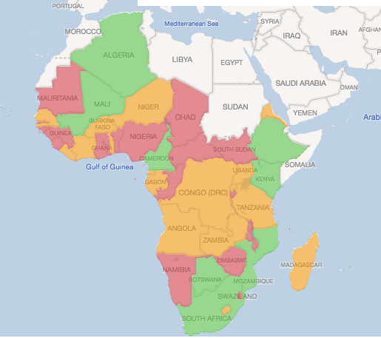
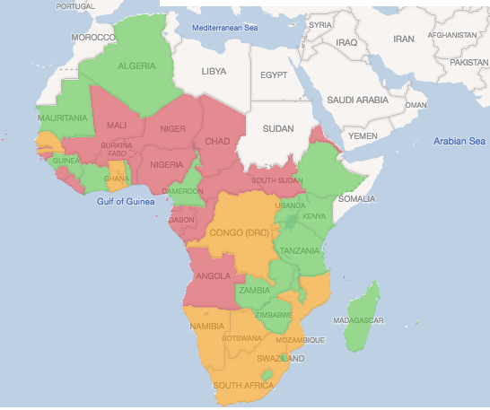
Country Readiness – IPC and Clinical Management
Overall case management readiness score 53%
Overall IPC readiness score 58%
Angola, DRC, Ghana, Mauritius, Kenya, Ethiopia, south Africa , Nigeria prioritized amongst the key countries in the region needing Immediate IPC support.
IPC experts being deployed to countries mentioned above
4 main activities targeted to IPC;
Coordination activities (MOH commissions or WG on IPC, partners etc)
IPC Training activities (working with MOH using interim guidance)
IPC at Point of Entry (PoE) activities
Healthcare facilities (HCF) activities
30 IPC experts identified for training and support to priority 2 and 3 countries.
Notes:
Readiness checklist was distributed to 47 countries and all member states responded.
Checklist covers 10 key pillars for preparedness and response
Overall regional readiness score is average score across all pillars

Slide 32
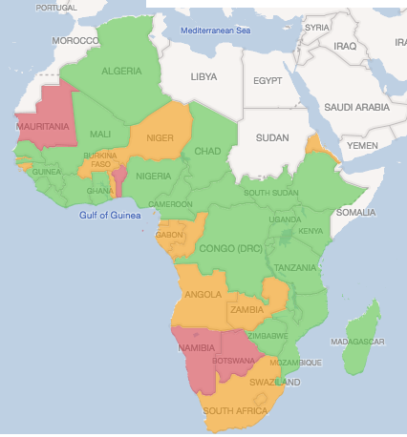
Country Readiness – Coordination
72% Countries with PHEOC (with IMS as coordination mechanism)
Many countries have activated PHEOC and established IMS for preparedness
Others transitioned to Alert mode while conducting preparedness activities
PHEOC Watch staff regularly monitoring evolution of the outbreak
91% Countries with multi-sectoral multi-agency coordination mechanism at policy level (high level engagement and commitment at policy level)
87% Countries have with preparedness and response plans for nCOV
WHO deployed Experts to 7 high priority countries (Cote d’Ivoire, Congo, Kenya, Nigeria, Senegal, Ethiopia, South Africa) to enhance coordination and provide technical support
Overall coordination readiness score 79%
ACTIONS NEEDED
Conduct simulation exercise to test plans and procedures with more focus on priority countries.
Support countries strengthen coordination and prepare plans (those without)
Notes:
Readiness checklist was distributed to 47 countries and all member states responded.
Checklist covers 10 key pillars for preparedness and response
Overall regional readiness score is average score across all pillars

Slide 33
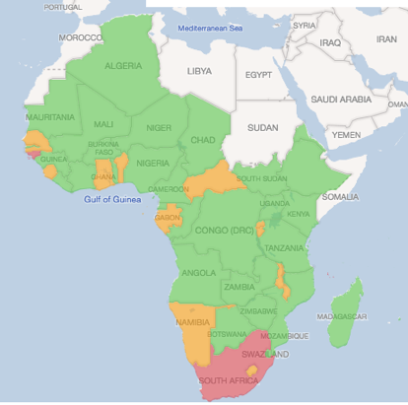
Country Readiness – Coordination and Logistics
Supply:
Realized: Supply of PPE and other IPC equipment to 12 highest priority countries.
In process: Supply of PPE and other IPC equipment to 9 additional priority countries.
Prepositioning of a regional contingency stock initiated.
Overall logistics readiness score 82%
Health Logistics:
Technical guidance developed
Support member states to strengthen PoE set up.
On going identification and assessment of treatment facilities in priority countries.
Notes:
Readiness checklist was distributed to 47 countries and all member states responded.
Checklist covers 10 key pillars for preparedness and response
Overall regional readiness score is average score across all pillars

Slide 34
More information and WHO resources
Online readiness dashboard available: click here
Ongoing monitoring of alert with an online dashboard created: http://arcg.is/1HCWan
Training packages ready and is on the shared drive: Click here
Website: www.EPI-WIN.com
COVID-19 website: https://www.who.int/health-topics/coronavirus

Slide 35
Enhanced surveillance and outbreak investigation for COVID-19

Slide 36

After a case of COVID-19 has been confirmed
Several actions need to happen concurrently to find additional cases and to prevent further spread, including:
Actively find cases
Thorough case and outbreak investigations
Conduct enhanced surveillance

Slide 37
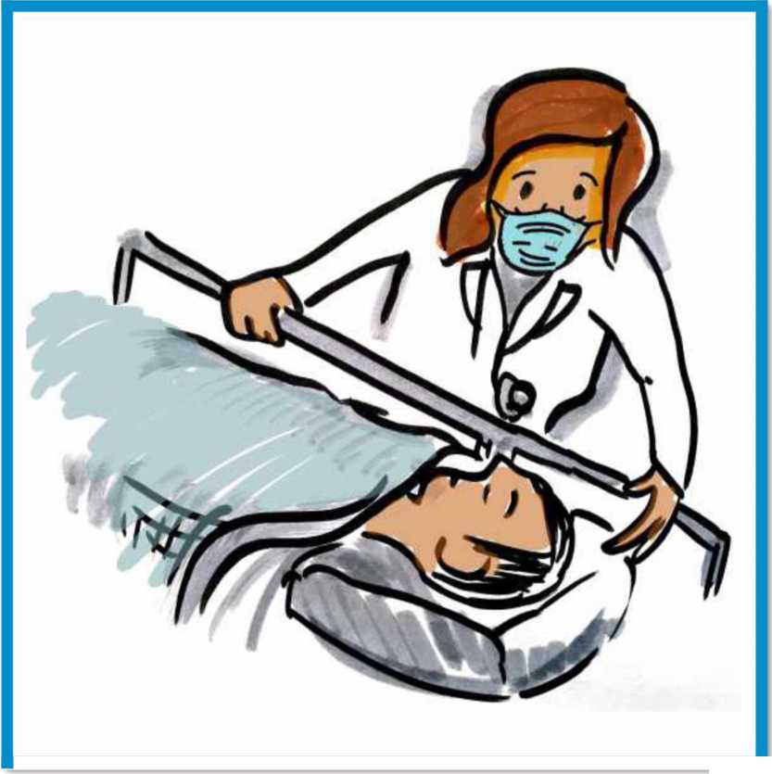
Active case finding
Active case finding involves a wider search, focusing on:
Patients and their visitors in health care facilities where the confirmed patient sought treatment
Health care providers who cared for or cleaned the room of an infected patient
Social, familial and work contacts of the infected patient

Slide 38
contact
Definition of contact
A contact is a person that is involved in any of the following: - Providing direct care without proper personal protective equipment (PPE)2 for COVID-19 patients - Staying in the same close environment of a COVID-19 patient (including workplace, classroom, household, gatherings). - Traveling together in close proximity (1 m) with a COVID-19 patient in any kind of conveyance within a 14‐day period after the onset of symptoms in the case under consideration.

Slide 39
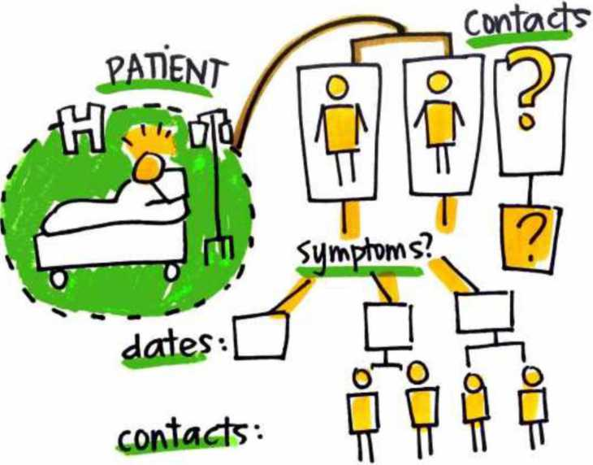
Contact tracing
Identify contacts of the infected patient and record:
Names, contact, demographic information
Date of first and last exposure or date of contact with the confirmed or probable case, and
Date of onset when fever or respiratory symptoms develop
The common exposures and type of contact with confirmed or suspected cases should be thoroughly documented for any contacts that become infected

Slide 40
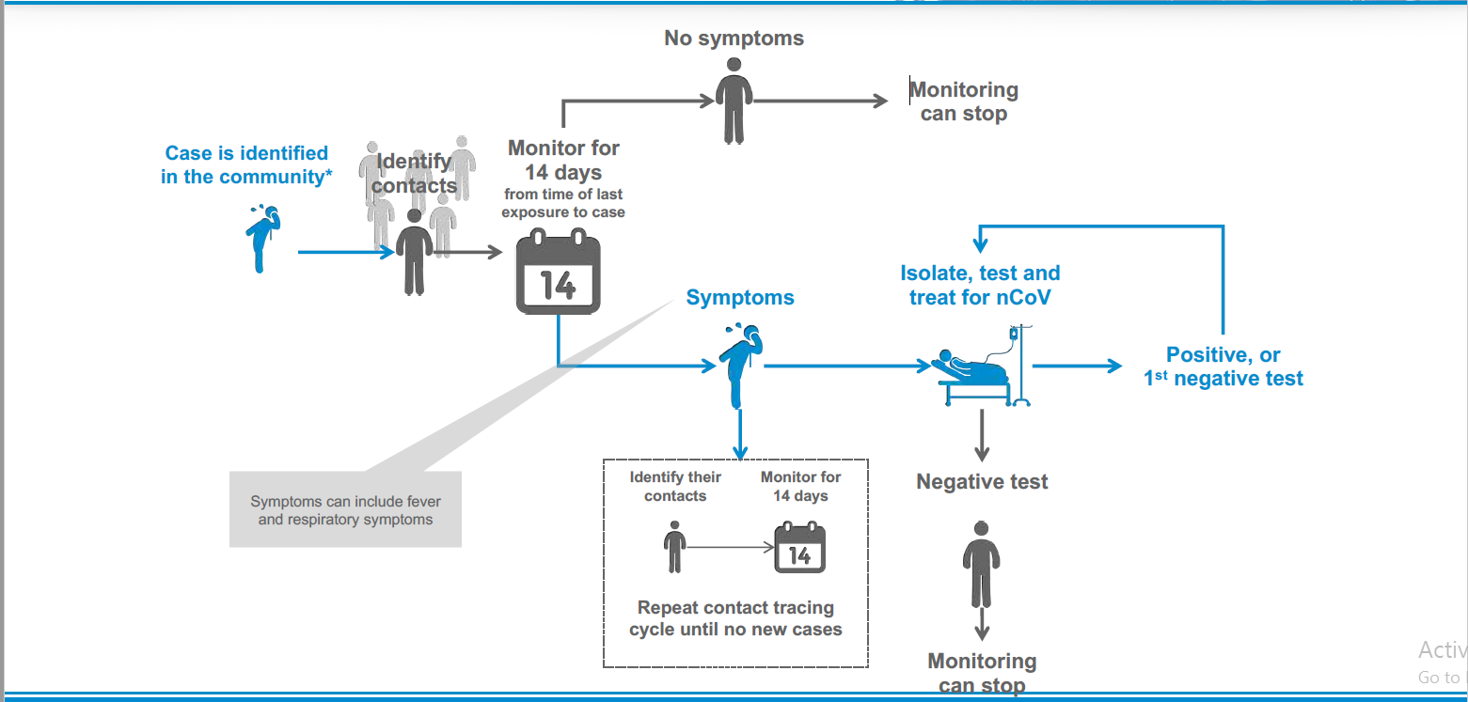
Contact tracing
(in community setting)

Slide 41
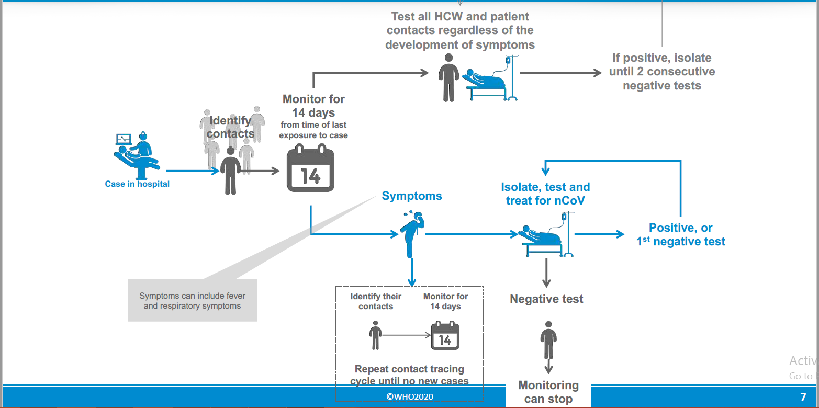
Contact tracing
(in health care setting)

Slide 42
Outbreak investigations for clusters or outbreaks of COVID-19

Slide 43

Convening an investigation team
Assemble a multi-disciplinary team with expertise in:
Field epidemiology
Clinical assessment
Biological specimen collection
Infection prevention and control
Risk communication and community engagement
It is essential that animal health specialists are included in the team - if warranted.
Additional team members: logisticians, laboratory experts, data managers and environmental health specialists.

Slide 44

Convening an investigation team
Before deploying, the team should:
■ Gather preliminary background information
■ Assemble the necessary materials and supplies (e.g. personal protective equipment, specimen collection and transport materials) and
■ Inform relevant local public health and animal health authorities

Slide 45
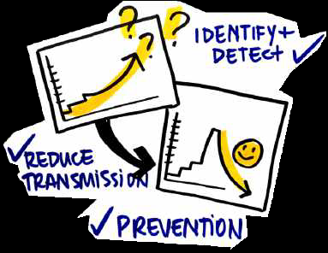
Investigation objectives
Prevent future cases through identification of potential human, animal and/or environmental sources of exposure, risk factors for infection, and implementation of appropriate prevention and control measures.
Public Health Objectives
Identify other cases and quickly detect any human to-human transmission.
Reduce onward transmission, morbidity and mortality through rapid identification, isolation, treatment and clinical management of cases and follow-up of contacts.

Slide 46

Investigation objectives
Determine key
epidemiological, clinical and virological characteristics for cases including:
■ clinical presentation,
■ natural history,
■ the mode(s) of transmission and disease diagnosis,
■ incubation period, period of transmissibility and
■ best practices for treatment.
Knowledge Objectives
Determine the size of the geographic area in which the virus is transmitting.
Determine if the efficiency of human-to-human transmission of the virus has changed or increased.

Slide 47
Investigations in health care settings
Location of the investigation:
■ Within the health care facilities where the patient visited and was treated
Objectives of your investigation:
■ Identify other cases who may have been in contact with the confirmed case or their biological specimens, including other patients, HCW, visitors
■ Identify how they were infected - that is, what exposures resulted in infection
■ Quickly recommend measures to stop transmission

Slide 48
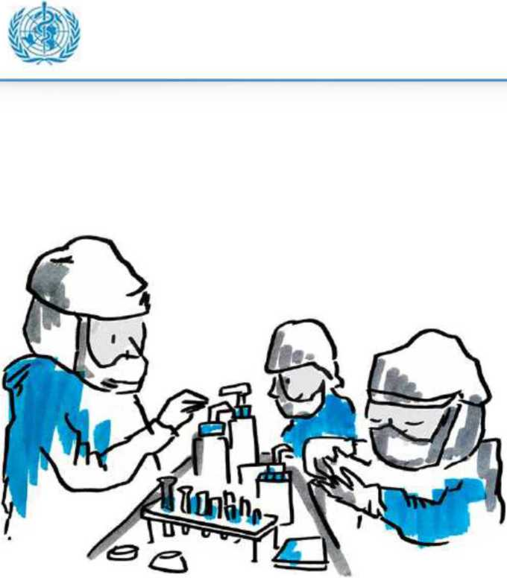
Enhanced surveillance
General surveillance in the area under investigation should be enhanced for at least one month, focusing on:
■ Setting up lab testing in the local health care facility, if feasible, or organizing rapid transfer of specimens to a laboratory with testing capacity
■ Informing local clinicians of the case definition and the need for vigilance
■ Surveillance for severe acute respiratory illnesses (SARI) in health care facilities in the community
■ Increasing testing of SARI cases at local health care facilities
■ If resources allow, testing of people with milder, influenzalike illness

Slide 49
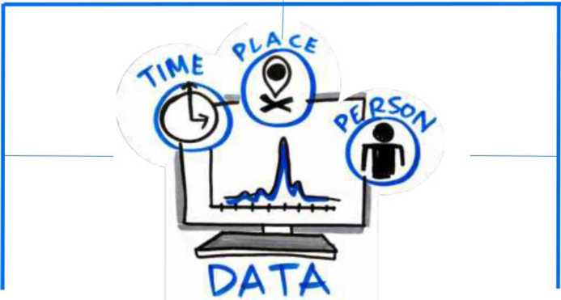
Data analysis
Descriptive analysis of cases should be performed in terms of time, place and person:
Place: geographical location: maps of the locale, case patients'
homes
Person: relationship (i.e. transmission or family trees) and demographic characteristics (e.g. distribution by age and sex) should be developed
Time: Date of onset: graphical and/or tabular descriptions of cases by date of onset: epidemic curve
Key epidemiological data (e.g. estimation of an incubation period, description of transmission patterns, attack rates by age, occupation, exposure history etc.) and clinical data (e.g. spectrum of illness severity, proportion with pneumonia, deaths)
should also be provided

Slide 50
What do you do with this analysis?
Data is critical for:
Analysis and interpretation - conduct a risk assessment
Design and implement mitigation measures
Share findings of outbreak investigations so that others can learn from experiences

Slide 51
LABORATORY TESTING FOR COVID-19

Slide 52
Laboratory sample type collected forlaboratory testing - 1
No | Specimen type | Collection materials | Condition of transportation | Storage temp | Comments
1 | Nasopharyngeal and oropharyngeal swab | Dacron or polyester locked swabs* | 4 °C | ≤5 days: 4 °C >5 days: -70 °C | The nasopharyngeal and oropharyngeal swabs should be placed in the same tube to increase the viral load
2 | Bronchoalveolar lavage | sterile container* | 4 °C | ≤48 hours: 4 °C >48 hours: –70 °C | There may be some dilution of pathogen, but still a worthwhile specimen
3 | (Endo)tracheal aspirate, nasopharyngeal aspirate or nasal wash | sterile container | 4 °C | ≤48 hours: 4 °C >48 hours: –70 °C
4 | Sputum | sterile container | 4 °C | ≤48 hours: 4 °C >48 hours: –70 °C | Ensure the material is from the lower respiratory tract

Slide 53
Laboratory sample type collected for laboratory testing - 2
No | Specimen type | Collection materials | Condition of transportation | Storage temp | Comments
1 | Tissue from biopsy or autopsy including from lung | sterile container with saline | 4 °C | ≤24 hours: 4 °C >24 hours: –70 °C
2 | Serum (2 samples acute and convalescent possibly 2-4 weeks after acute phase) | Serum separator tubes (adults: collect 3-5 ml whole blood) | 4 °C | ≤5 days: 4 °C >5 days: –70 °C | Collect paired samples: • acute – first week of illness • convalescent – 2 to 3 weeks later
3 | Whole blood | collection tube | 4 °C | ≤5 days: 4 °C >5 days: –70 °C | For antigen detection particularly in the first week of illness
4 | Urine | urine collection container | 4 °C | ≤5 days: 4 °C >5 days: –70 °C

Slide 54
Information to be provided to accompany laboratory testing - 2
No | Information type | Information details
1 | Patient information | name, date of birth, sex and residential address, unique identification number, other useful information (e.g. patient hospital number, surveillance identification number, name of hospital, hospital address, room number, physicians’ name and contact information, name and address for report recipient)
2 | Time information | Date and time of sample collection, date of symptom onset
3 | Site information | Anatomical site and location of specimen collection
4 | Laboratory tests requested and clinical information | Tests requested
5 | Clinical information | Clinical symptoms and relevant patient history (including vaccination and antimicrobial therapies received, epidemiological information, risk factors).
6 | Place information | Location and/or GPS if applicable

Slide 55
Infection prevention measurements during sample collection
No | Measures for biosafety
1 | Sample collectors use the adequate PPE and well trained in its use
2 | Sample collectors adhere to Standard operating procedures for sample collection
3 | Additional precautions are available for aerosol-generating procedures such as aspiration or open suctioning of respiratory tract specimens, intubation, cardiopulmonary resuscitation, bronchoscopy) use additional precautions such as: Respirators (NIOSH-certified N95, EU FFP2 Eye protection (i.e. goggles or a face shield) Clean, long-sleeved gown and gloves
4 | Sample collection procedures are performed in an adequately ventilated room

Slide 56
Infection prevention measurements during sample collection
No | Measures for biosafety
1 | Trained sample transporters are used for sample carriage
2 | Strick adherence to IATA regulations
3 | Number of persons present in the room is limited
4 | Donning and doffing PPE procedures are strictly adhered to
5 | Adequate waste management and decontamination procedures are available and adhered to

Slide 57
Packaging and shipment
No | Measures for biosafety
 | Transport of specimens within national borders should comply with applicable national regulations
 | International Transport Regulations. Novel coronavirus specimens should follow the UN Model Regulations, and any other applicable regulations
 | Samples from suspected or confirmed cases should be transported as UN3373, “Biological. Substance, Category B”. Viral cultures or isolates should be transported as Category A, UN2814, “infectious substance, affecting humans”.

Slide 58
Tests to be performed in expert laboratories
No | Type of sample | Comments
1 | RT-PCR | Respiratory sample to be done by an expert laboratory
2 | Nucleic acid amplification tests for CoVID -19 | Respiratory sample to be by an expert laboratory until validation has been finalized
3 | Whole genome sequencing | Collect on presentation to be done by an expert laboratory
4 | Serology, broad corona virus serology on paired samples if available | Paired samples necessary for confirmation, the first sample collected in week 1 of illness and the second collected 3-4 weeks later. If a single serum sample can be collected, collect at least 3 weeks after onset of symptoms. Done by expert laboratory until more information on performance of available assays

Slide 59
Reporting of cases and test results
No | Reporting requirement
1 | Laboratories should follow national reporting requirements, but in general, suspected cases should be reported to relevant public health authorities as soon as results are produced
2 | All test results, whether positive or negative, should likewise be immediately reported to national authorities
3 | National level notify WHO as an obligation to the IHR requirement within 24 hours

Slide 60
Infection Prevention and Control for 2019 Novel Coronavirus Infection

Slide 61
Goals of Infection Prevention and Control
Protect yourself
Protect your community
Protect your patients

Slide 62
Principles of infection prevention & control strategies associated with health care with suspected (COVID -19)
Ensuring triage, early recognition, and source control (isolating patients with suspected (COVID-19).
Application of Standard Precautions for all patients
Implementation of empiric additional precautions (droplet and contact and whenever applicable airborne precautions) for suspected cases. Consider Airborne precautions for aerosol-generating
procedures
Administrative controls.
Environmental and engineering controls.

Slide 63
Ensuring triage, early recognition, and source control
  Encourage HCWs to have a high level of clinical suspicion, and use updated case definitions
  Establish a well-equipped triage station at the entrance of health facilities
  Reinforce adherence to standard precautions especially respiratory hygiene and hand hygiene
  Ensure that patients with symptoms of suspected (COVID-19)or other respiratory infection (e.g., fever, cough) are not allowed to wait among other patients seeking care. Provide a face mask to symptomatic patients

Slide 64
Applying standard precautions for all patients
  Hand hygiene
  Respiratory hygiene
  Appropriate personal protective equipment (PPE) according to risk assessment
  Injection safety practices/Sharps safety
  Safe waste management
  Proper linens, environmental cleaning and sterilization of patient-care equipment.

Slide 65
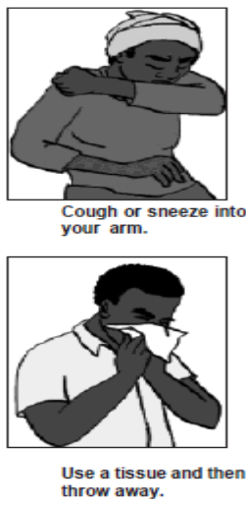

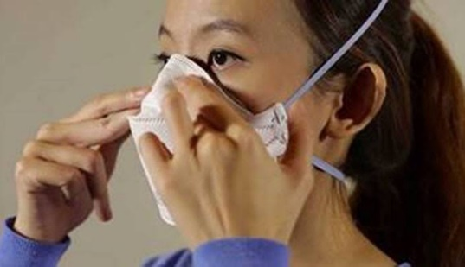

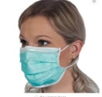
Respiratory or cough etiquette
Cover mouth and nose when coughing and sneezing
Maintain social distance (1.5metres) from others
Cover mouth and nose with tissue and dispose of the used tissues in the nearest waste bin
Health workers must put on fit tested N95 masks before entering the patient area or patient care
Offer a face mask to patients with suspected 2019-nCoV infection while they are in waiting/public areas or in isolation rooms.

Slide 66
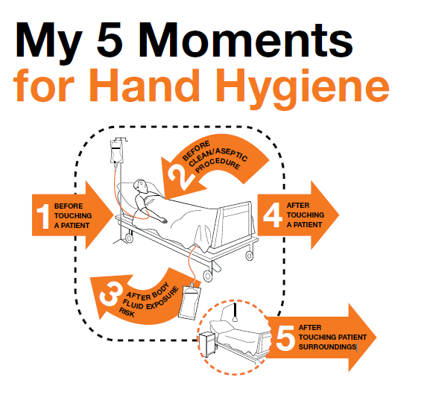
Hand hygiene
Hand hygiene is the most important measure to prevent infection
Perform hand hygiene after contact with respiratory secretions.

Slide 67
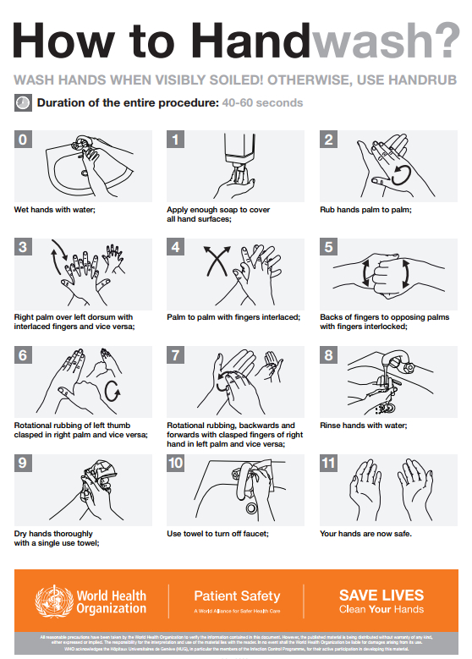
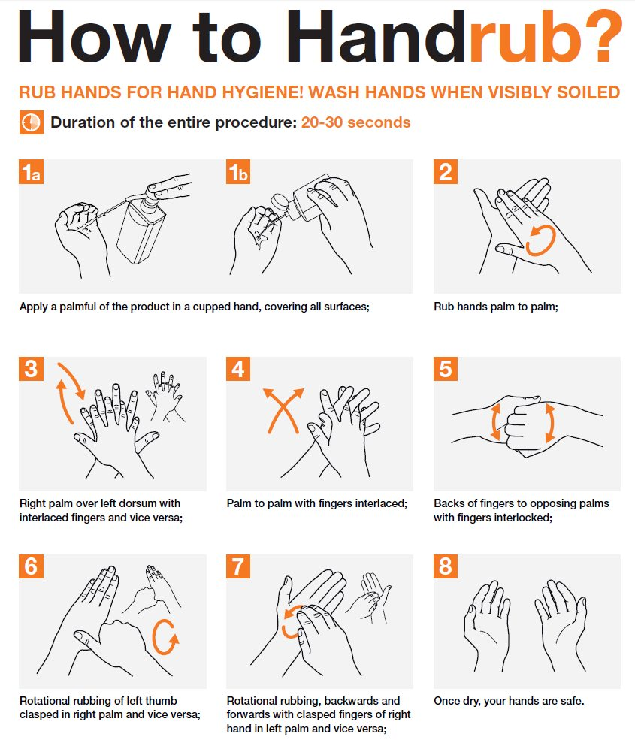

Slide 68
Personal protective equipment (PPE)
PPE recommendation for the general public:
  For asymptomatic individuals, no PPE use is recommended. However proper hand hygiene practices and respiratory etiquette should suffice
For Health workers Supporting Triage or high risk gatherings
  I addition to standard precautions, rapidly identify people with respiratory symptoms and put a face mask on them.
  Screening teams should use fitted N95 respirators
  Symptomatic staff are advised to stay home and inform relevant authorities
For Health workers caring for confirmed cases
  In addition to standard precautions, health workers to use facial protection (Goggles), fitted respirators, gowns, gloves, and observe the 5 moments of hand hygiene

Slide 69
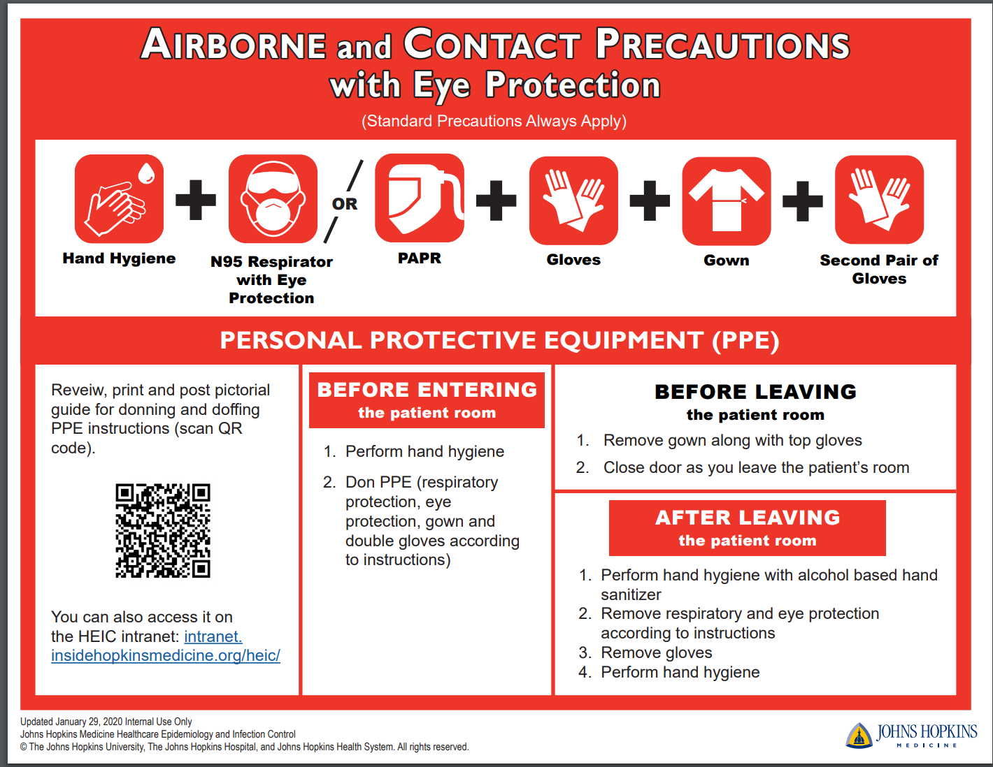

Slide 70
Risk assessment for appropriate use of PPE
Minimize direct unprotected exposure to blood and body fluids.
SCENARIO | HAND HYGIENE | GLOVES | GOWN | MEDICAL MASK | EYE- WEAR
Always before and after patient contact, and after contaminated environment | x
If direct contact with blood and body fluids, secretions, excretions, mucous membranes, non-intact skin | x | x
If there is risk of splashes onto the health care worker’s body | x | x | x
If there is a risk of splashes onto the body and face | x | x | x | x | x

Slide 71
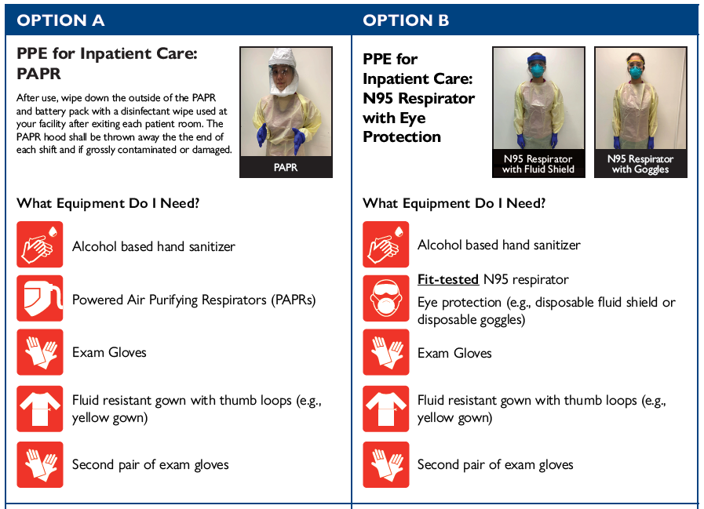
Personal protective equipment (PPE)

Slide 72
Implementing empiric additional precautions
Patients should be placed in adequately ventilated single rooms.
when single rooms are not available, patients suspected of being infected with 2019-nCoV should be grouped together (Cohorting)
All patients’ beds should be placed at least 1 m apart regardless of whether they are suspected to have 2019-nCoV infection or not

Slide 73
Additional Contact and droplet precautions
Use designated equipment for patients under investigation/Confirmed patients
If transport is required, use predetermined transport routes to minimize exposure for staff, other patients and visitors, and have the patient using a medical mask;
Routinely clean and disinfect surfaces which the patient is in contact
Maintain a record of all persons entering the patient’s room, including all staff and visitors.

Slide 74
Isolation
Room doors should be kept closed except when entering or leaving the room, and entry and exit should be minimized. Patient movement out of the room should be minimized as well
Once a proper isolation room, the patient’s facemask may be removed.
Outside the isolation room, patients should wear a facemask to contain secretions and droplets
Personnel entering the room should use PPE, including respiratory protection, as described below.
In addition, the room should undergo appropriate cleaning and surface disinfection before it is returned to routine use.

Slide 75
Implementing administrative controls
Administrative controls and policies for the prevention and control of transmission of infections within the healthcare setting include
  Establishing sustainable IPC infrastructures and activities;
  Educating patients’ caregivers;
  Developing policies on the early recognition of acute respiratory infection potentially caused by 2019-nCoV;
  Ensuring access to prompt laboratory testing for identification of the etiologic agent;
  Preventing overcrowding, especially in the emergency department;
  Providing dedicated waiting areas for symptomatic patients;
  Appropriately isolating hospitalized patients;
  Ensuring adequate supplies of PPE;
  Ensure the adherence of IPC policies and procedures for all facets of health care.

Slide 76
Administrative measures related to healthcare workers
Provision of adequate training for HCWs
Ensuring an adequate patient-to-staff ratio
Establishing a surveillance process for acute respiratory infections potentially caused by 2019-nCoV among HCWs
Monitoring HCW compliance with standard precautions and providing mechanisms for improvement as needed.

Slide 77
Using environmental and engineering controls
Spatial separation of at least 1 meter should be maintained between all patients.
Ensure that cleaning and disinfection procedures are followed consistently and correctly.
Cleaning environmental surfaces with water and detergent and applying commonly used hospital disinfectants (such as sodium hypochlorite) is an effective and sufficient procedure.
Manage laundry, food service utensils and medical waste in accordance with safe routine procedures.

Slide 78
Recommendation for outpatient care
  Triage and early recognition
  Emphasis on hand hygiene, respiratory hygiene and facemasks to be used by patients with respiratory symptoms
  Prioritization of care of symptomatic patients
  When symptomatic patients are required to wait, ensure they have a separate waiting area have a facemaks
  Educate patients and families about the early recognition of symptoms, basic precautions to be used and which health care facility they should refer to.

Slide 79
Summary of recommendations
General Public | Screening and High risk Gatherings | Patient care setting
Observe proper hand hygiene using ABHR or soap and water Keep a 2m distance from patients with respiratory symptoms Try as much as possible to avoid hand contact with facial mucosa Proper respiratory manners No PPE required | Put face masks on a patients with respiratory symptoms Observe standard precautions Stay home when you are sick | Use of PPE including Disposable Gowns, goggles, respirators, gloves and hand hygiene Dedicate equipment for use on PUIs for nCov19 Monitor and manage all exposed and symptomatic HCWs

Slide 80
References
Infection prevention and control during health care when novel coronavirus (2019-nCoV) infection is suspected Interim guidance 25 January 2020. WHO
Interim Infection Prevention and Control Recommendations for Patients with Known or Patients Under Investigation for 2019 Novel Coronavirus (2019-nCoV) in a Healthcare Setting. CDC

